Slide 1

Multi-Agent AI Framework for Automated Software Development
AI Framework for Automated Software Development
Team Members:
2420030444 – Suhitha Chalasani
2420030398 – Kapilavai Hamsini
2420030472 – Sri Raaga Tangirala
Cluster – 2, Section 7

Slide 2
PROBLEM STATEMENT
Traditional SDLC is manual and slow across requirements, design, coding, testing, and documentation.
A single LLM can't handle a full project end-to-end — too much breadth and complexity.
Tools like ChatDev, MetaGPT, and AgentCoder generate isolated snippets, not complete multi-file projects.
Need: a system that takes one requirement and carries it through planning, coding, review, testing (with retries), and documentation on its own.

Slide 3
OBJECTIVES
Build a 4-agent pipeline — Planner, Coder, Tester, Reviewer — each owning one SDLC.
Use LangGraph to sequence agents, share state, and manage retries.
Keep one shared state object (spec, code, test results, review verdicts, retry counts) so agents don't lose context.
Use Groq's gpt-oss-120b (Planner/Reviewer) and gpt-oss-20b (Coder/Tester) — fast, free-tier, no GPU needed.
On test/review failure, loop back to the Coder automatically, capped by a retry limit.

Slide 4
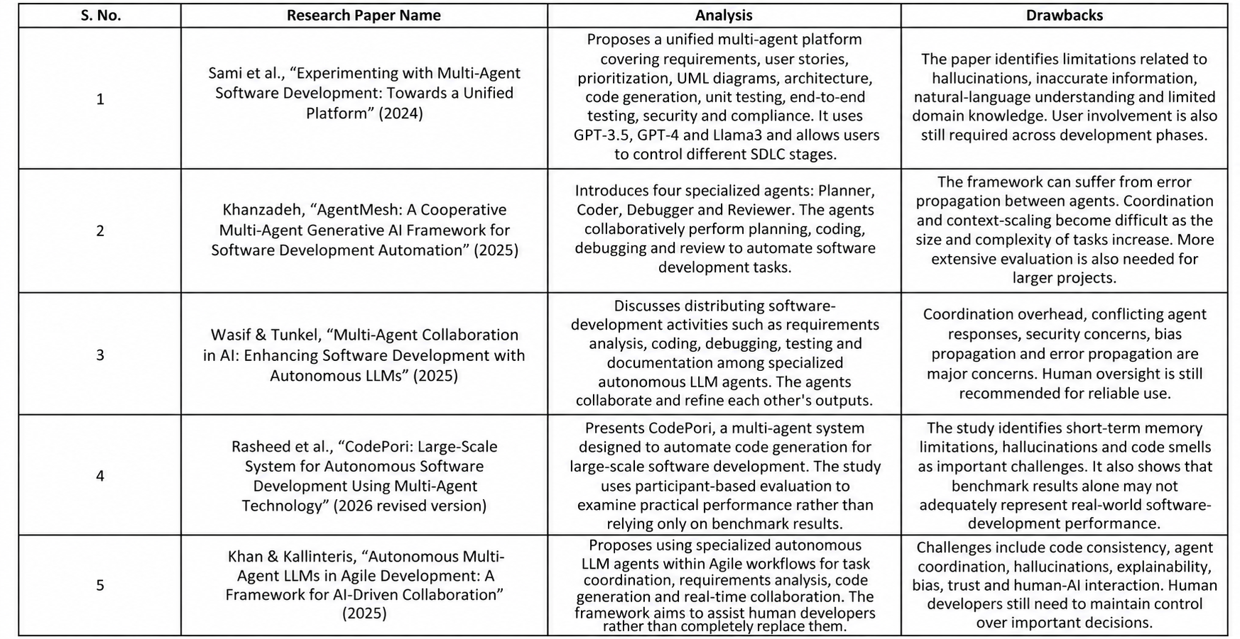
Literature Survey

Slide 5
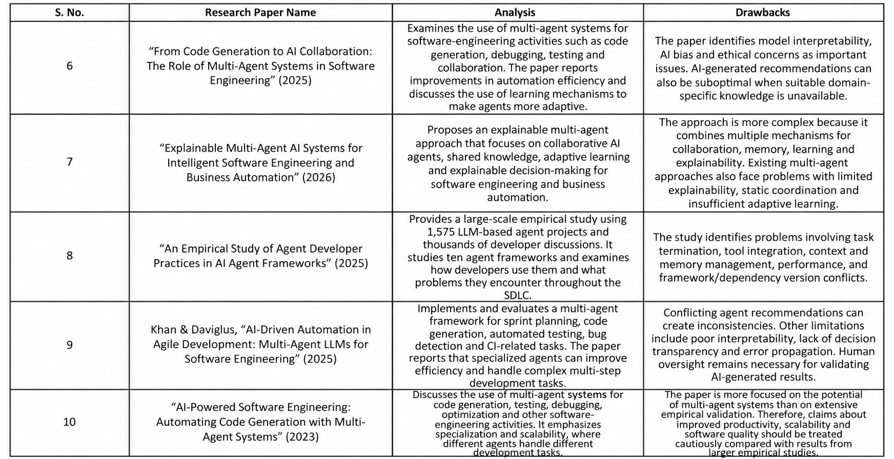
Literature Survey

Slide 6
RESEARCH GAPS IDENTIFICATION
ChatDev/MetaGPT/AgentCoder produce isolated functions, not full projects with a real test-to-code feedback loop.
CodePori's evaluation found hallucination, cross-file memory loss, and orchestration failures — issues standard benchmarks miss.
AgentMesh has a debugging loop but no orchestrator for multi-file coordination.
Sami et al.'s platform separates requirements/architecture/code well but has no automatic retry loop on test failure.
Most literature relies on paid closed models (GPT-3.5/4, Claude) — leaves room for a fast, low-cost, open-weight approach via Groq.

Slide 7
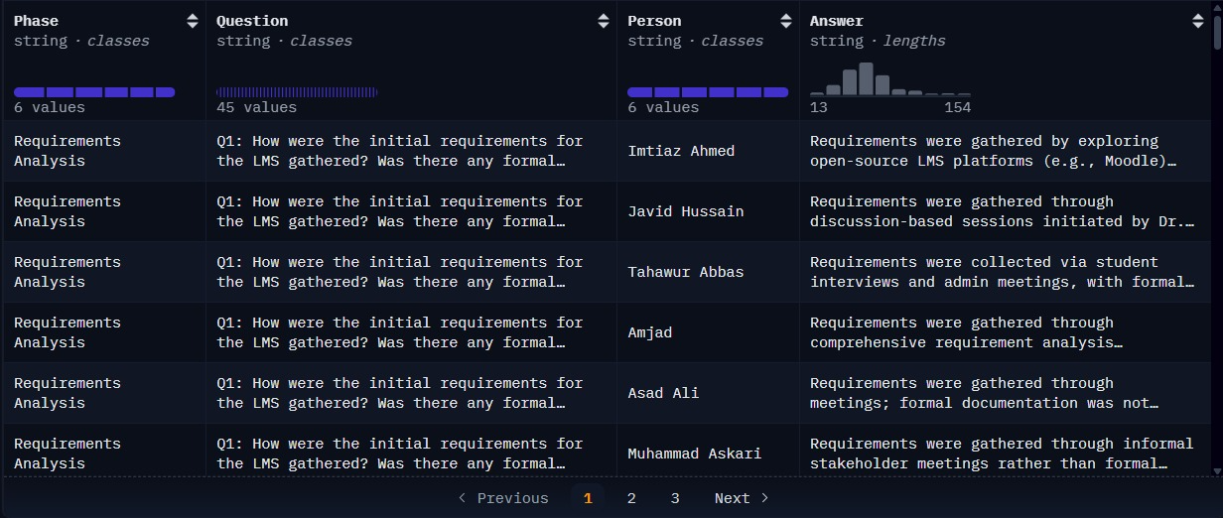
DATASETS
Datasets
HuggingFace | https://huggingface.co/datasets/BasitAliii/sdlc-scenario-based-qa-dataset
Kaggle | ai_multi_agent_interactions_2026.csv
Github | https://github.com/GPT-Laboratory/CodePori_v02

Slide 8
INNOVATION, CREATIVITY & NOVELTY
LangGraph explicitly manages sequencing, state, and retry loops — not a fixed linear pipeline.
Mixed-model routing: gpt-oss-120b for Planner/Reviewer, gpt-oss-20b for Coder/Tester — free-tier vs. paid APIs used elsewhere.
Every agent returns fixed, Pydantic-validated JSON instead of relying on shaky free-tier tool-calling.
Model IDs live in env vars, so swapping providers (already done once after Llama 3.x was deprecated) is a config change, not a code change.
Sandboxed execution closes the safety gap AgentMesh flagged — subprocess isolation + timeout + POSIX resource limits, with three real bugs found and fixed via live runs

Slide 9
FEASIBILITY
Every component (Flask, LangGraph, Groq API, Pydantic, Git) is existing, maintained tech.
Groq's free tier removes the GPU/hosting cost barrier.
Similar pipelines (CodePori, AgentMesh, Sami et al.) already prove this approach works, even if output quality still needs work.
The retry loop is a standard LangGraph conditional edge, not a novel challenge.
Known risks (hallucination, short memory, code smells) are documented, so review/testing stages are planned for them upfront.

Slide 10
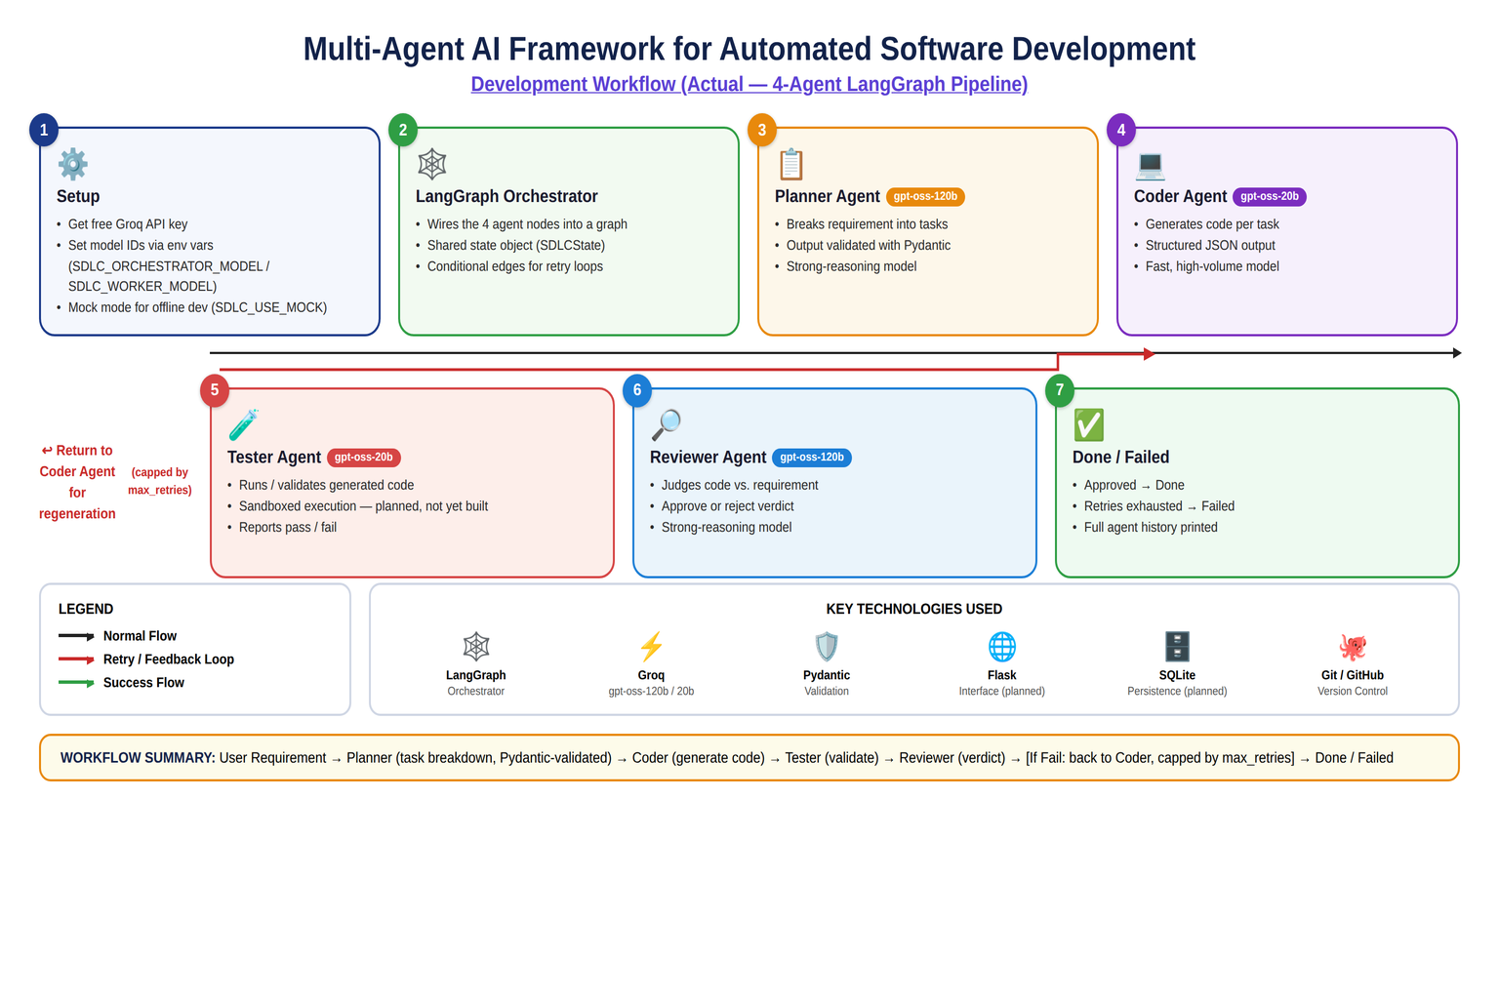
PROJECT PLAN

Slide 11
METHODOLOGY
Pipeline & Agent Roles
Four-stage cyclic pipeline: Plan → Code → Test → Review — with failures routed back to the Coder instead of halting, not a linear script.
One shared, persisted state object carries the spec, code, test results, verdicts, and retry counters across every stage- Human-in-the-loop approval gate right after planning: a generated spec (requirement + acceptance criteria + tasks) is approved or rejected by a human before any code is generated.
Planner (gpt-oss-120b) → structured Spec; Coder (gpt-oss-20b) → code per task as JSON; Tester (gpt-oss-20b) → real sandboxed test per criterion; Reviewer (gpt-oss-120b) → verdict against real evidence, proven to refuse rubber-stamping unverified results.
Built waterfall-first; Agile-readiness fields (backlog, sprint_number) already sit in the schema so a later sprint loop means new edges, not a rewrite.

Slide 12
METHODOLOGY
Validation & Retry Strategy
Every agent's output is forced into a fixed JSON shape and validated with Pydantic — malformed responses are caught as typed errors, never silently corrupting state.
A static syntax check runs on every Coder/Tester code payload right after schema validation, catching semantically-broken-but-schema-valid Python before it executes.
Two independent, capped retry budgets: spec_approval_retries (human rejects the plan) and test_review_retries (code fails tests or review)- test_review_retries raised from 3 → 5 based on real evidence — complex specs (5–7 criteria) were burning the full budget on infrastructure hiccups, not code-quality issues.
A run that exhausts its budget terminates FAILED cleanly with full attempt history — never a silent hang or crash.

Slide 13
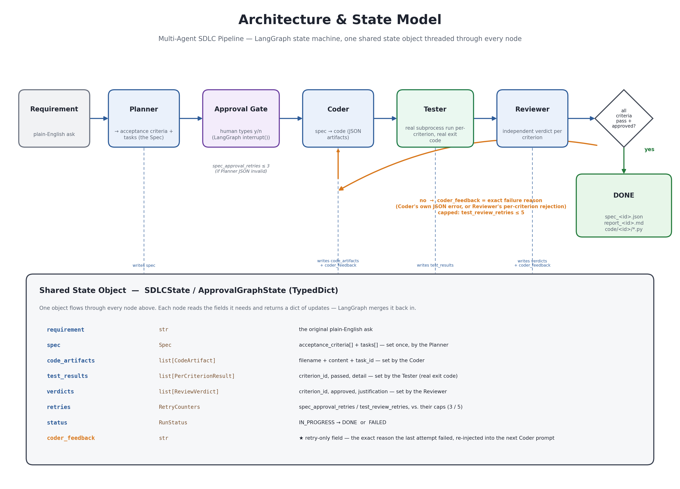
SYSTEM DESIGN
Architecture & State Model

Slide 14
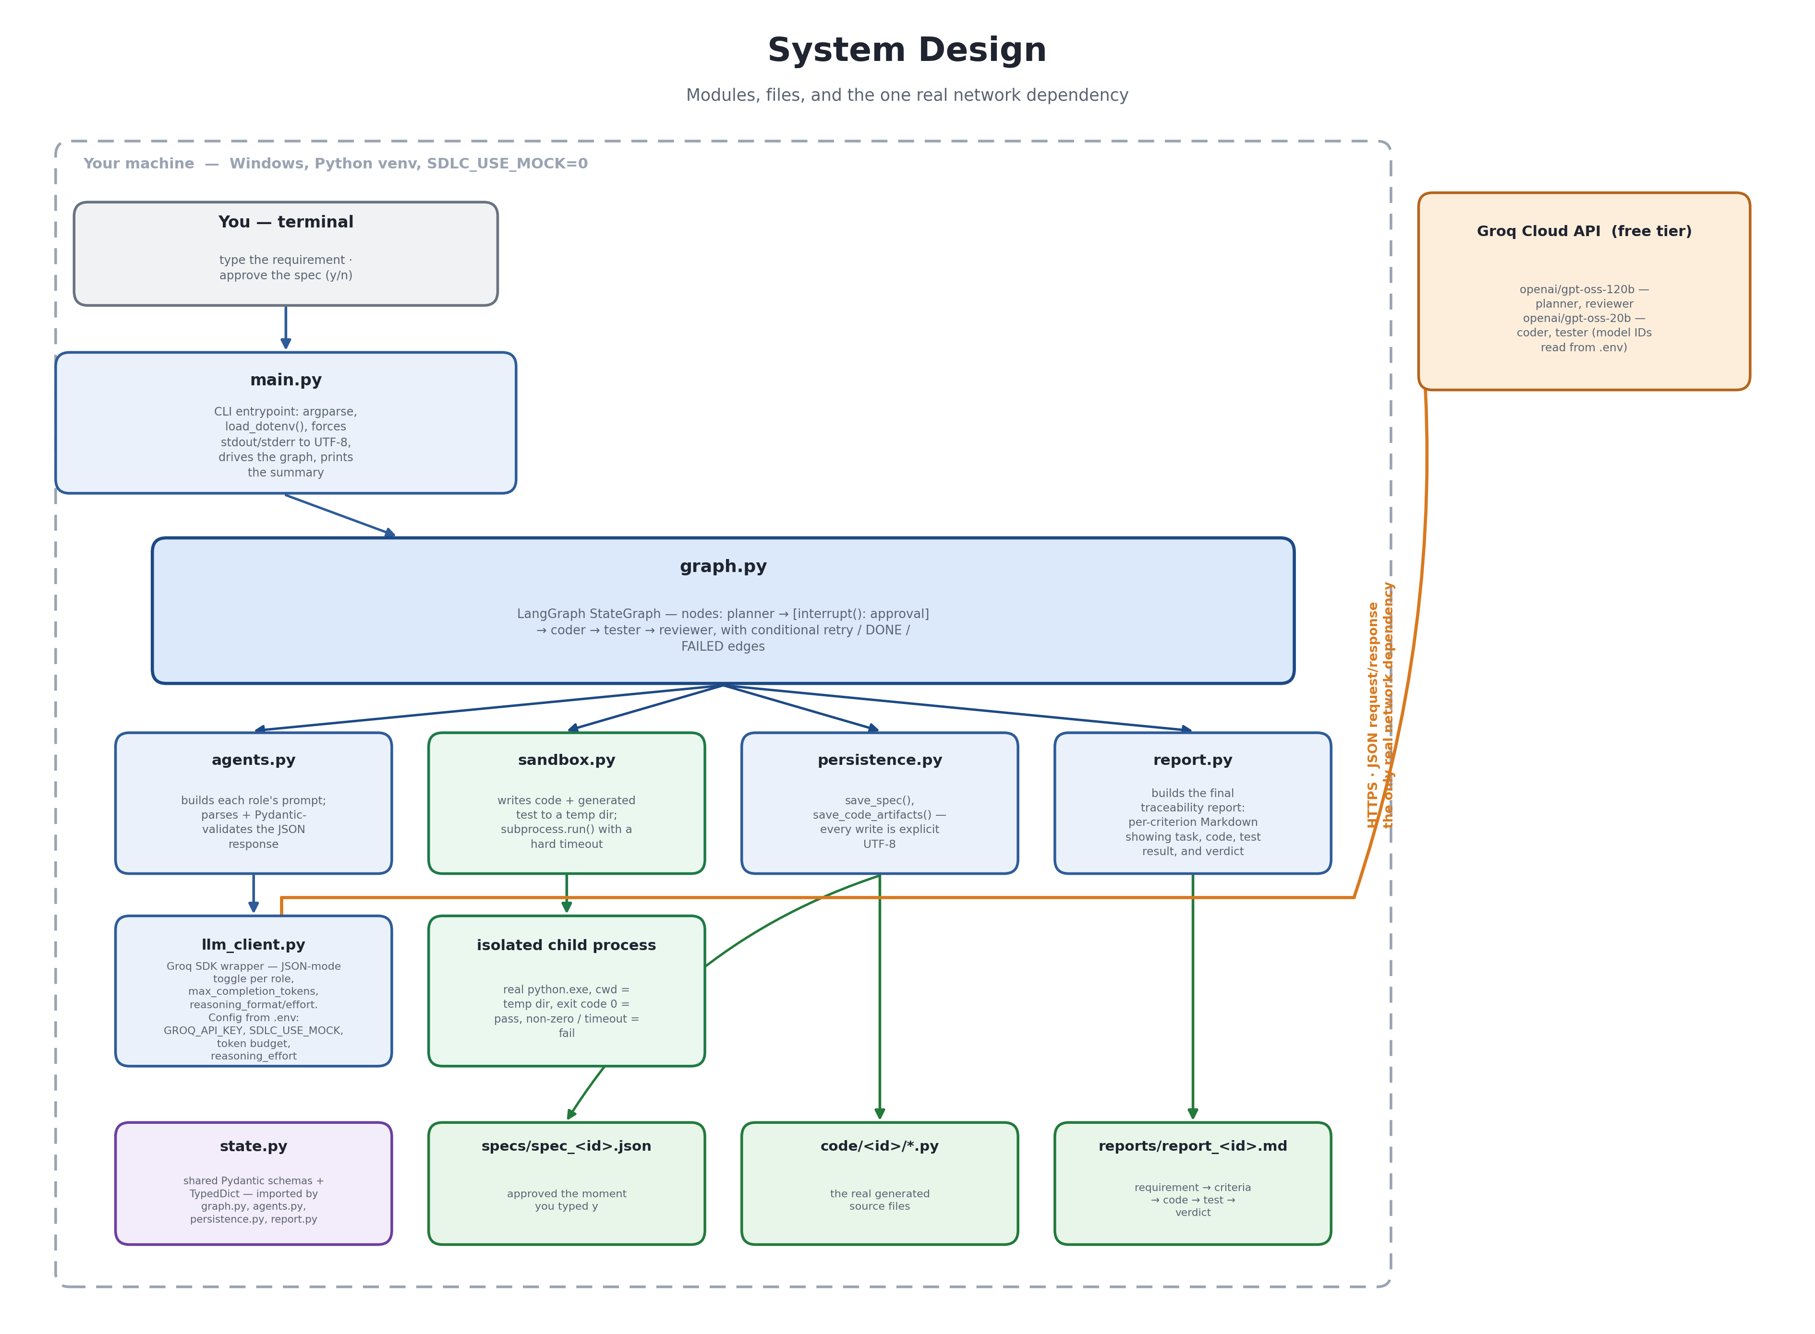
SYSTEM DESIGN
Execution Flow

Slide 15
MODERN TOOLS AND TECHNOLOGIES
Orchestration: LangGraph — needed for branching, cyclic, stateful control flow (retries, human-in-the-loop) that a simple linear chain can't express.
LLM hosting: Groq free tier — gpt-oss-120b and gpt-oss-20b, fast inference, no GPU or paid API cost.
Validation: Pydantic v2 — every agent boundary is a validated model, not a trusted raw string; the single most load-bearing tool in the stack.
Sandboxing: Python's subprocess + resource modules — wall-clock timeout as the primary limit, POSIX CPU/memory rlimits as a backstop.
Config: model IDs and tunables read from environment variables via python-dotenv — swapping a deprecated model is a one-line .env change, already proven when Groq deprecated its original LLaMA models.
Persistence (planned): SQLite; Frontend (planned): Flask with Server-Sent Events for live run status

Slide 16
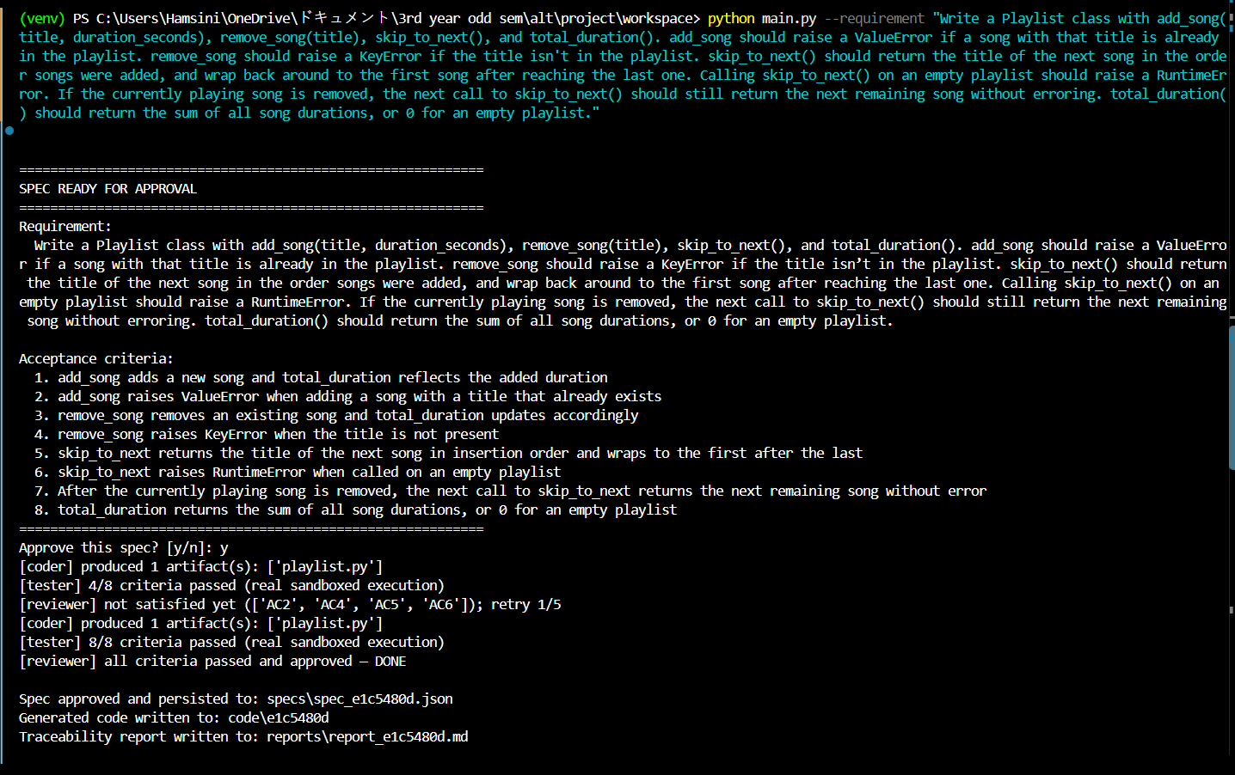
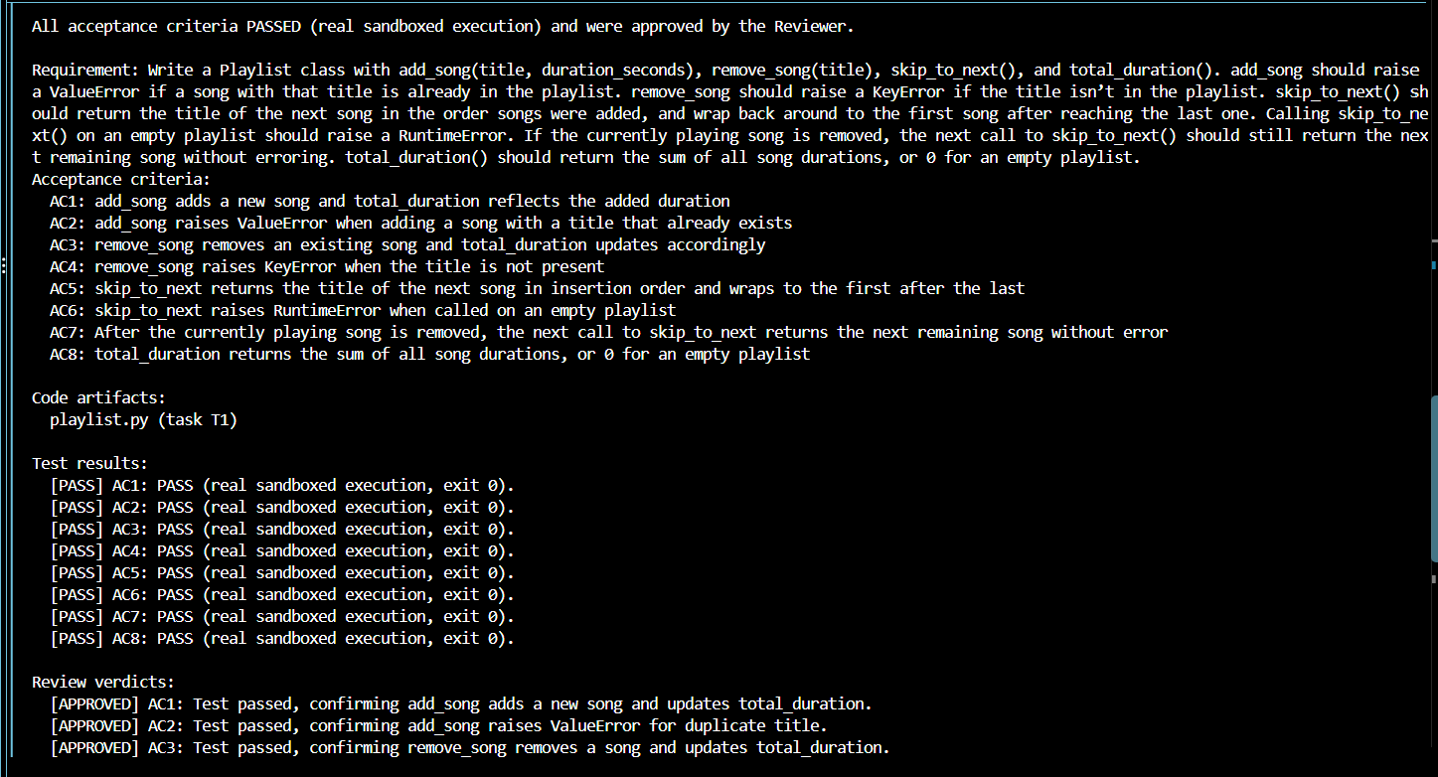
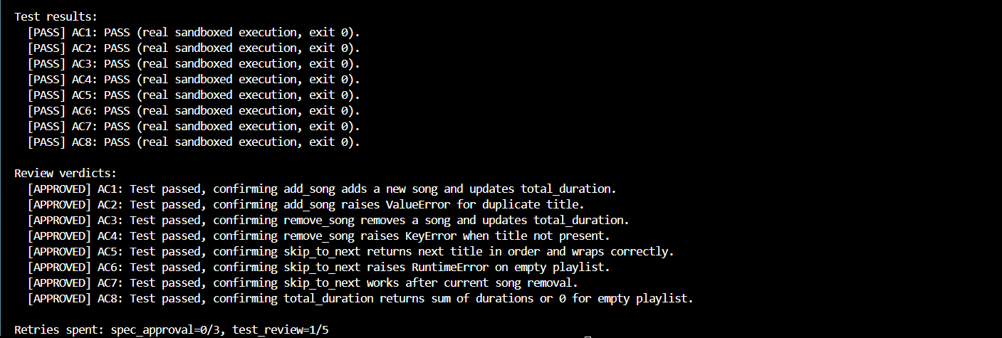
IMPLEMENTATION
Build Timeline & Sandboxed Execution

Slide 17
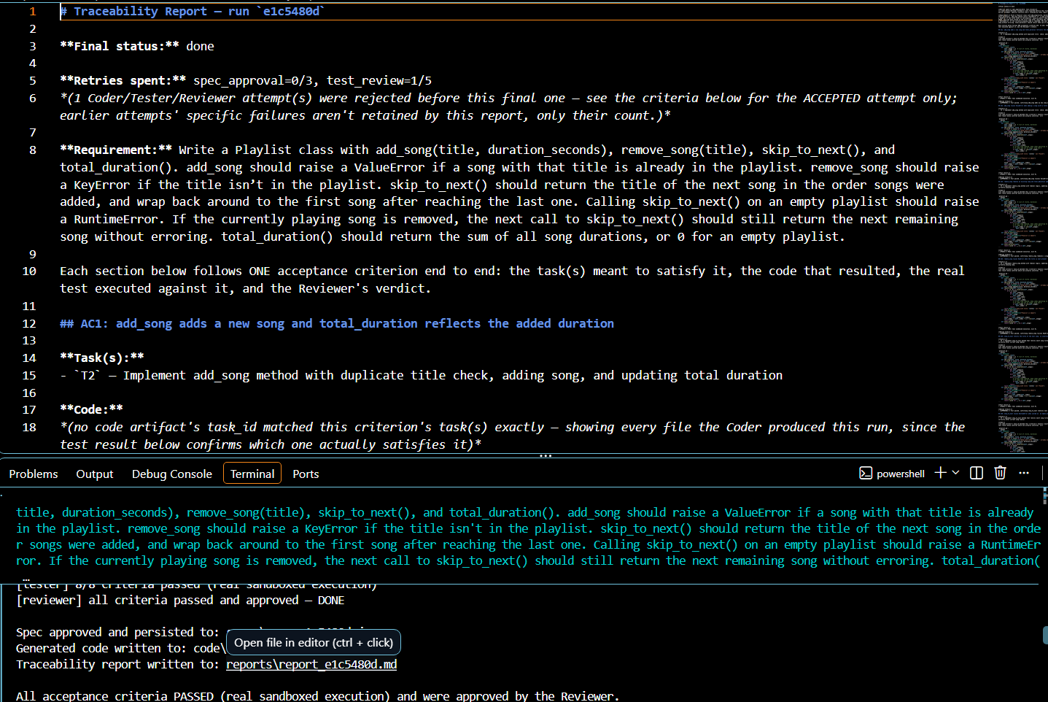
IMPLEMENTATION
Bugs Fixed & Traceability Reporting

Slide 18
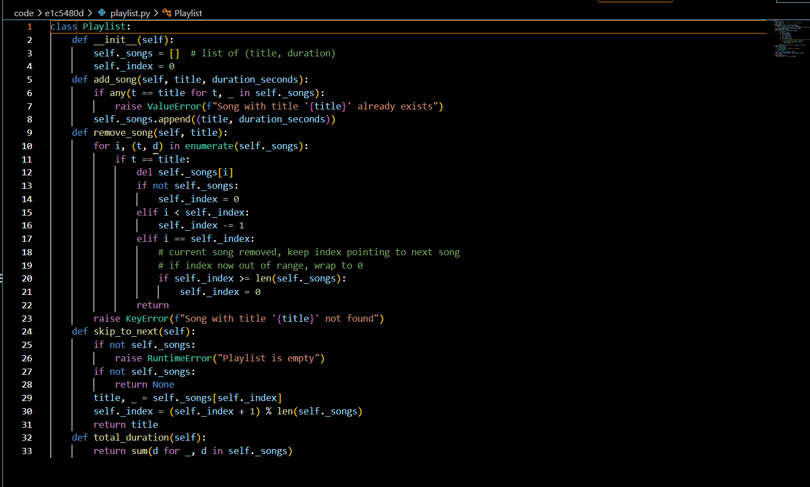
RESULTS

Slide 19
PERFORMANCE EVALUATION
End-to-end success rate: 6/12 real runs (50%) reached DONE; both post-fix complex runs (8 and 9 criteria) reached DONE with zero retries — evidence the Phase 6 bug fixes materially improved reliability.
Retry budget tuning was evidence-driven: cap raised 3 → 5 specifically because 5–7-criterion specs were exhausting 3 retries on format/infrastructure issues, not genuine logic errors.
Sandbox timing safety: CPU-limit backstop now buffered 2 seconds above the wall-clock timeout, non-flaky across 5 consecutive runs post-fix.
Known limitations: no live FAILED run yet has a fully populated live-Groq retry trail in its report; Windows-specific resource limiting is reasoned through but not verified on an actual Windows interpreter; no live rate-limit (429) has actually been hit yet, so backoff is verified by review, not by a real throttling event.

Slide 20
Thank you

